Slide 1
First DIBBS
An Introductory Workshop for Suppliers Interested in Selling to the DLA
The Defense Logistics Agency Internet Bid Board System

Slide 2
AGENDA
Welcome & Introductions
Alphabet Soup
What is DIBBS and Why Does it Matter?
Supplier Roles: Distributor vs Manufacturer
Doing Your Homework: Market Research
Requirements to Participate
Basic Cybersecurity Overview
Solicitation Overview/Go/No Go Decisions
Delivering the Goods: Packaging, Marking & Shipping
Resources

Slide 3
Introductions
Mark Johnson with Washington APEX Accelerator at Economic Alliance of Snohomish County. Mark has his BA in Public Policy from the University of Washington.
Before APEX, Mark worked in state and local government, and consulted a county government on program development
Prior to his time in the public sector, Mark developed his skillset working for small businesses. His experience seeded a passion for helping small businesses grow, helping communities thrive through economic empowerment and skill development.

Slide 4

Who is APEX Accelerator?
Designated as the lead Government Procurement Technical Assistance provider by the Department of Defense.
Our team of 17 advisors increase the number of government contracts that are awarded to businesses in Washington State via no-cost advising with 30+ years experience using national best practices
Headquartered at Thurston EDC, in partnership with subrecipients including Economic Alliance Snohomish County
We help with: Trainings, Workshops, Networking Events, Market Research, Certifications, Registrations, Strategy, Marketing, Solicitation Review, Bid Review, and Post Award Assistance

Slide 5

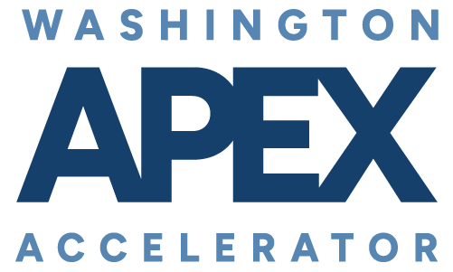

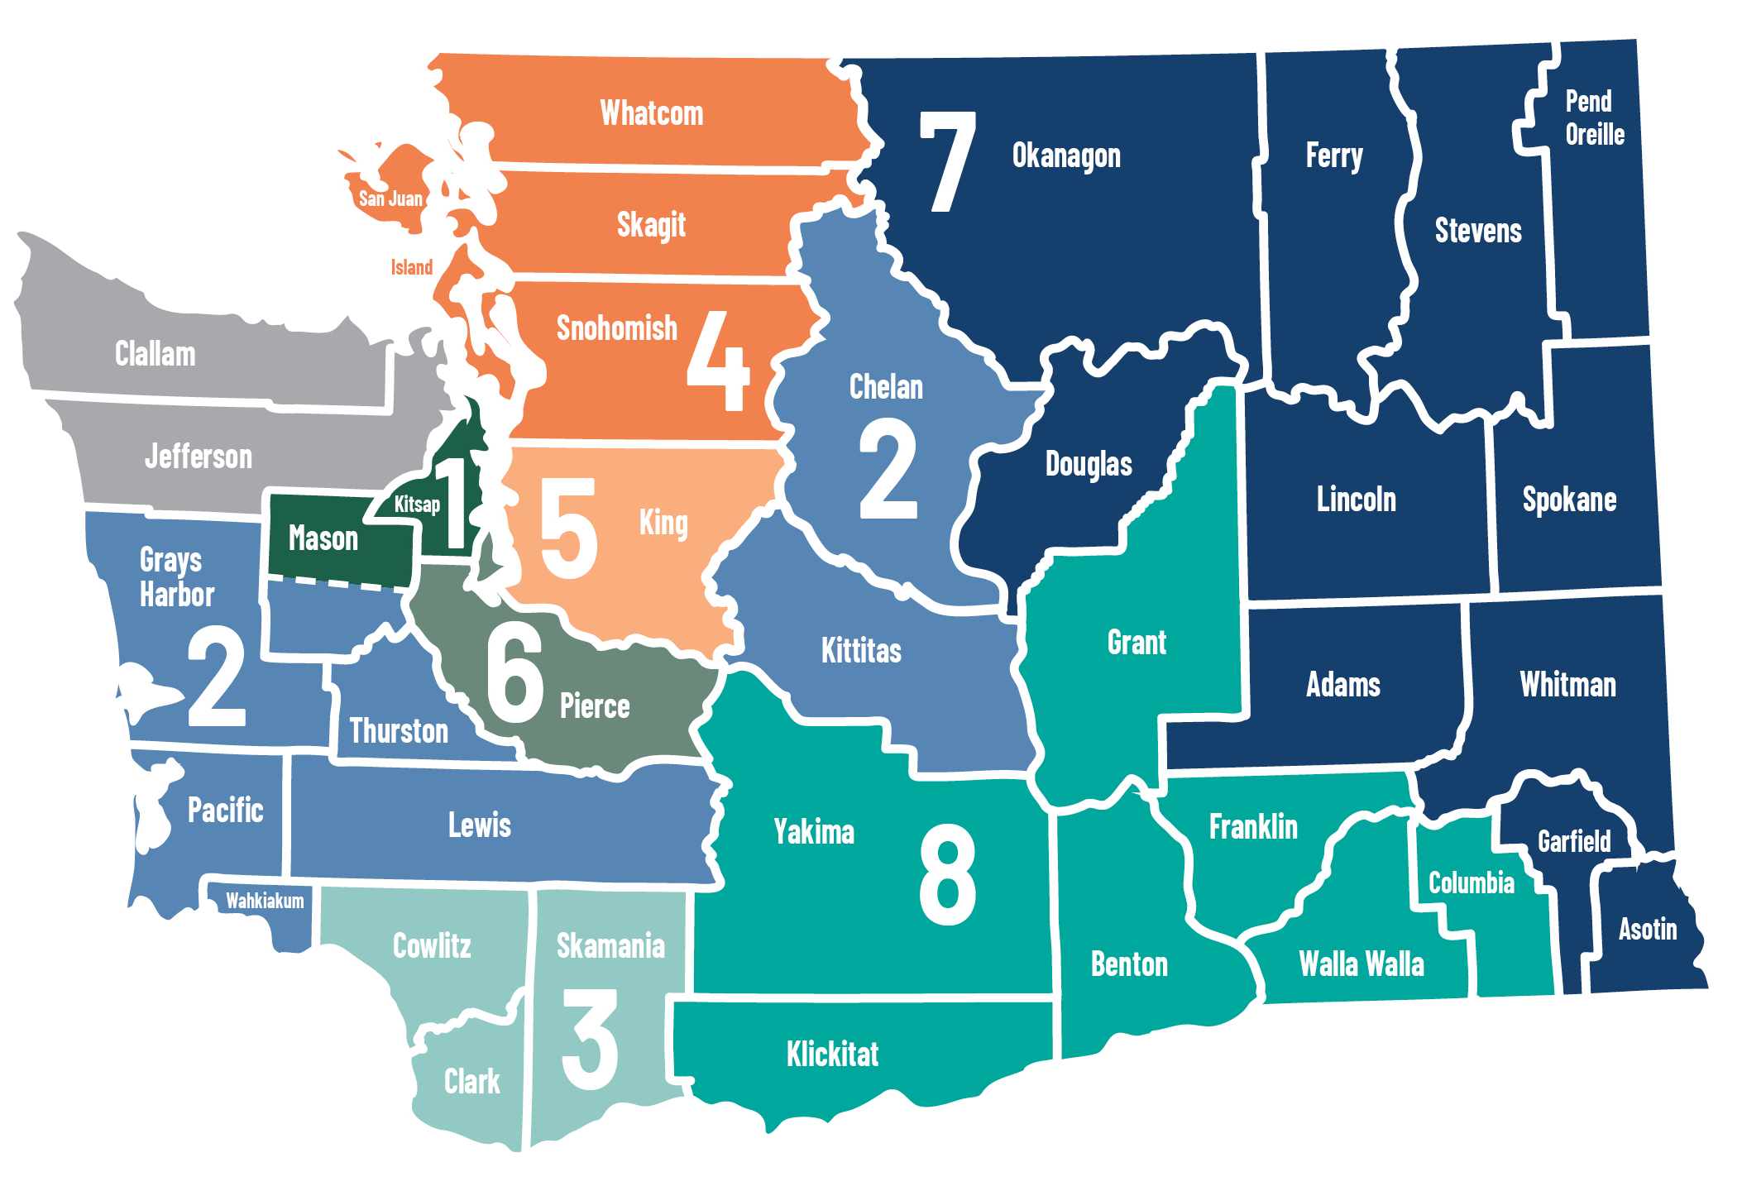





Other APEX Accelerators Serving Washington State
1 Kitsap Economic Development Alliance
  Mary Jo Juarez, Terry Homburg, James Davis
North Olympic Peninsula
APEX Accelerator:
clallam.org/apex
American Indian Chamber Education Fund APEX Accelerator: aicef-apex.org
NW Native Apex Accelerator:
nnapex.org
2 Thurston Economic Development Council
  Grady Smith
Innovation & SBIR Program
washingtonapex.org/sbir
3 Columbia River Economic Development Council
  Julia Krivoruk
4 Economic Alliance Snohomish County
  Cara Buckingham, Mark Johnson
5 Green River College
  Darrell Sundell, Melinda Martirosian
6 Washington APEX Accelerator in Pierce County
  Trena Payton, Maryam Lynch-Tate
7 Greater Spokane Incorporated
  Aleesha Roedel
See full staff listing at washingtonapex.org/about-apex/staff
8 Tri-City Regional Chamber of Commerce
  Maria Alleman
360.860.6945 info@washingtonapex.org washingtonapex.org
“This APEX Accelerator is funded in part through a cooperative agreement with the Department of Defense.”
Notes:
This is a editable map.
MUST have all fonts installed on your computer to see it properly.

Slide 6





Thank You Program Supporters
Notes:
https://securitybricks.io/
https://www.portseattle.org/page/how-do-business-port
https://www.des.wa.gov/sell/how-work-state
https://www.seattle.gov/purchasing-and-contracting/doing-business-with-the-city

Slide 7
U.S. Federal Procurement Hierarchy
Slide 1 of 2
GSA / SAM.gov
General Services Administration • System for Award Management
State
Treasury
Justice
Interior
Agriculture
Commerce
Labor
War
(DoW)
HHS
Education
Energy
Transport.
HUD
Homeland
Security
Veterans
Affairs
Note: SAM.gov is the federal vendor registration system operated by GSA — vendors must register before receiving contracts. GSA is the actual procurement agency. DoD is highlighted as the path to DIBBS (see Slide 2).

Slide 8
Department of War — Organizational Structure (Line-and-Block Chart)
Department of War
Secretary of War
Office of the
Inspector General
(Independent)
Deputy Secretary of War
Office of the
Secretary of War
Department
of the Army
Department
of the Navy
Department
of the Air Force
Joint Chiefs
of Staff
Principal Staff Assistants
(Under Secretaries)
Secretary of the Army
Secretary of the Navy
Secretary of the Air Force
Chairman, JCS
(CJCS)
The Army
The Navy
Marine Corps
The Air Force
Space Force
The Joint Chiefs
+ Joint Staff
(A&S) → DLA / DIBBS ★
NAVSUP
Defense Agencies (19)
DoD Field Activities (8)
Unified Combatant Commands (10)
Defense Advanced Research Projects Agency
Defense POW/MIA Accounting Agency
Defense Media Activity
U.S. Africa Command
Defense Commissary Agency
Defense Security Cooperation Agency
Defense Technical Information Center
U.S. Central Command
Defense Contract Audit Agency
Defense Security Service
Defense Technology Security Administration
U.S. Cyber Command
Defense Contract Management Agency *
Defense Threat Reduction Agency *
DoD Education Activity
U.S. European Command
Defense Finance and Accounting Service
Missile Defense Agency
U.S. Indo-Pacific Command
Defense Health Agency *
National Geospatial-Intelligence Agency *
DoD Human Resources Activity
U.S. Northern Command
Defense Information Systems Agency *
National Reconnaissance Office
DoD Test Resource Management Center
U.S. Southern Command
Defense Intelligence Agency *
National Security Agency / CSS *
Office of Economic Adjustment
U.S. Special Operations Command
Defense Legal Services Agency
Pentagon Force Protection Agency
Washington Headquarters Services
U.S. Strategic Command
Defense Logistics Agency * ★ (DIBBS)
U.S. Transportation Command
* Designated Combat Support Agency (CSA) per 10 USC §193. ★ = DIBBS focus — DLA operates DIBBS under USD(A&S). Overall structure established per 10 USC §111 & DoDD 5100.01.

Slide 9
DoW Procurement Deep Dive — DIBBS
Slide 2 of 2
Dept. of War (DoW)
★ Presentation Focus ★
DLA / DIBBS
Defense Logistics Agency • Internet Bid Board System
Army
SAM / GSA
/ DIBBS
Air Force
SAM / GSA
/ DIBBS
Navy &
Marine Corps
NAVSUP
Space Force
SAM / GSA
/ DIBBS
SOCOM &
Other
SAM / GSA
/ DIBBS
NAVSUP
Naval Supply Systems Command
Serves Navy & Marine Corps
Note: NAVSUP (Naval Supply Systems Command) serves both the Navy and Marine Corps. Other DoD branches use a combination of SAM, GSA, and DIBBS for procurement.

Slide 10


What is DIBBS?
The Defense Logistics Agency (DLA) Internet Bid Board System (DIBBS) is a procurement site where the DLA sources supplies (goods) for the armed forces.
Some DIBBS functions:
View solicitations
Submit quotes
View long term contract opportunities
View provisions, clauses, and Packaging specifications
View award history
View drawings/Technical data (cFolders – JCP/eJCP)
Assess forecast via Supplier Requirements Visibility Application (SRVA)
Access Supplier Performance Risk System (SPRS)

Slide 11
Alphabet Soup
DIBBS – Defense Logistics Agency Internet Bid Board System
DLA – Defense Logistics Agency
SAM – System for Award Management
CAGE – Commercial and Government Entity
JCP – Joint Certification Program (eJCP)
CMMC – Cybersecurity Maturity Model Certification
NIST – National Institute of Science and Technology (Referencing NIST Interim cybersecurity rule)
CUI – Controlled Unclassified Information
FCI – Federal Contract Information
COTS – Commercial Off the Shelf
SRVA - Supplier Requirements Visibility Application
SPRS - Supplier Performance Risk System
SAR – Source Approval Request
VSM – Vendor Shipment Module
QUP – Quantity Unit Pack
NSN – National Stock Number
FSC – Federal Supply Classification
PSC – Product Service Code

Slide 12
Why DIBBS Matters
Substantial market: In FY24, DLA procured over $52 billion dollars worth of goods, with $20 billion going to small businesses
  DLA Demand Forecast Report 24: PowerPoint Presentation
Variety of procured items: this includes food, fuel, apparel, pharmaceutical, medical, and surgical products & equipment, and weapons system repair parts (down to nuts and bolts)
Consistent demand: Defense procurement is steady, even in downturns
Open to small businesses: Many awards go to small, veteran-, minority-, and woman-owned firms via set-asides
Low barrier to entry: You don’t need to be a manufacturer—distributors can and do win
Millions in awards posted daily: Opportunities range from <$1K to $1M+

Slide 13
Common Mistakes
Underestimating Cybersecurity
Not taking packaging requirements seriously
Skipping market research

Slide 14
The Two Pathways
Manufacturer
Distributor

Slide 15
Supplier Roles: Manufacturer vs. Distributor
There are two relationship dynamics between a vendor and the DIBBS system, the distributor and the manufacturer.
Manufacturer: A manufacturing vendor with an approved CAGE that makes the approved part being requested by a DLA buyer – actually creates the goods being purchased by the DLA.
Distributor: A logistics vendor that sources the approved part via approved sources being requested by a DLA buyer – is an intermediary between the manufacturer and the DLA buyer.
Note:
A manufacturer can act as their own distributor, but a distributor cannot pose as a manufacturer.
A distributor typically cannot compete with a manufacturer who sells to the DLA directly (look at awarded cage in award history in the solicitation)

Slide 16
Market Research – Is There a Viable ROI?

Slide 17
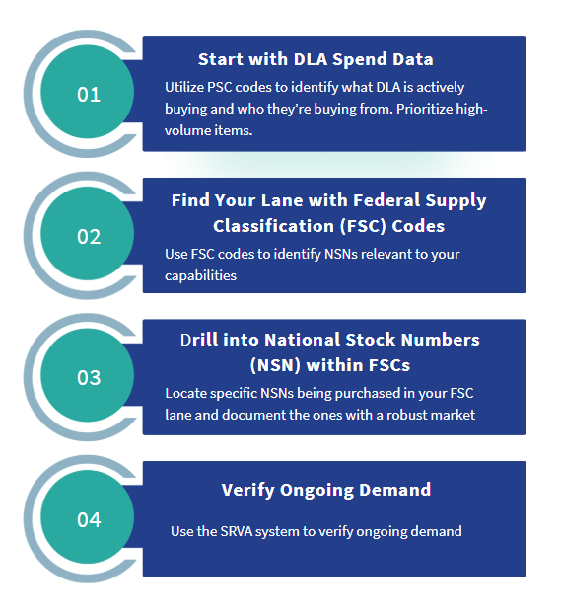
Market Research Process
These steps provide a tangible way to approach finding the right opportunity for your business in DIBBS
*Note – PSC codes and FSC codes are interchangeable, but we will reference them as they are presented by the DLA

Slide 18

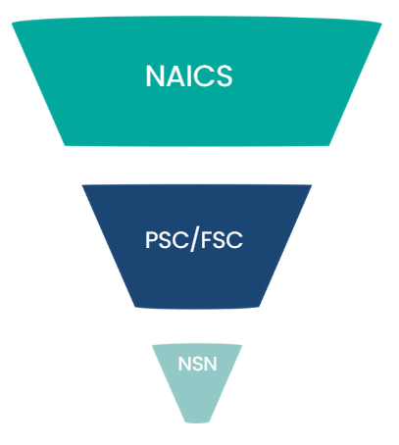
By this point, you should have NAICS codes selected as it’s required for SAM registration.
North American Industry Classification System (NAICS) codes
Product Service Code (PSC)
Federal Supply Class (FSC)
National Stock Number (NSN)
FSC and PSC codes are interchangeable. Agencies select how to identify the code. Think of FSC/PSC as a further filtering after NAICS codes, with NSNs being the final filter to the individual product level

Slide 19
Step 1: Start with DLA Spend Data
Start by reviewing PSC codes and documenting which ones match your capabilities (control F is your friend
here). Once documented, run them through the DLA’s Product & Service Search.
Product Service Codes (PSC): Product and Service Code Manual | Acquisition.GOV
Product & Service Search: https://www.dla.mil/Small-Business/Getting-Started/Product-and-Service-Search/
Why:
Product & Service search shows total DLA spend by product/service category which can help you understand the market on a grand scale.
You can see which categories DLA buys the most—great for prioritizing if your operation is flexible.
*Note which NAICS codes are listed

Slide 20
Step 2: Use PSC/Federal Supply Classification Codes to Find Your Lane
In the DIBBS system itself, go to the “Requests for Quotation (RFQ)” option under “Solicitations.” Filter search category by FSC, and enter the FSC of interest. Review boxes below but don’t limit your search at this point. (Note, manufacturers want to select 1G items with technical documents).
Be sure to note frequent flyer NSNs to validate in the next stage.
FSCs help you:
Identify product categories the government is buying
Align DIBBS opportunities with what you already sell or source
Avoid wasting time chasing random one-offs

Slide 21
Step 3: Confirm National Stock Numbers Within Your FSCs and Document Target NSNs
After making a list containing NSNs of interest, use RFQ and RFP search functions per each individual NSN to validate.
Make note of:
Parts with frequent buys and good margins
1G Solicitations with accessible technical data (manufacturer)
Solicitations with an approved source (distributor)
Vendor Opportunities and Forecasts – Contains a “No Bid Solicitation List,” a searchable Excel doc containing solicitations that haven’t been quoted on. You can run target NSNs through this list. (check DIBBS for accuracy before bidding)

Slide 22
Step 4: Verify Ongoing Demand – SRVA Forecasting Portal
The SRVA (Supplier Requirements Visibility Application) is a tool used by the Department of Defense (DoD) to provide visibility into anticipated requirements for suppliers. It allows users to access up to 24 months of projected purchase order (PPO) quantity information, helping to reduce lead times and improve customer support.
*Note – you will need to be in the DIBBS system to access the SRVA
Link to SRVA: DIBBS Log In

Slide 23
Requirements to Participate in DIBBS
How many of you are registered in SAM?

Slide 24
Requirements to Participate
Manufacturer
Needs access to technical documents
SAM.gov account
  CAGE Code
Register in DIBBS
CMMC Level 1 (soon)
Register in PIEE
Register in SPRS
NIST Score/CMMC level 1 attestation uploaded to SPRS
Get JCP certification
Register in cFolders (30 day inactivity lockout)
Distributor
Needs to plan for upcoming cybersecurity requirements
SAM.gov account
    CAGE Code
Register in DIBBS
CMMC Level 1 (soon)
    Some exempt COTS solicitations

Slide 25
Cybersecurity
Call to action per DLA:
  “Strengthening cybersecurity measures is crucial for handling and protecting information as cyber-threats continue to grow. To enhance DLA's cybersecurity and better protect DoD information, the Cybersecurity Maturity Model Certification (CMMC) Program was created to empower Vendors to align with DoD cybersecurity requirements in order to work with the Government.”

Slide 26
Cybersecurity – CMMC/NIST
CMMC Level 1 — Federal Contract Information (FCI) Required for contracts where systems store, process, or transmit non-public contract information
Annual self-assessment against 15 basic safeguarding requirements (FAR 52.240-93 / 52.204-21)
Active as of November 10, 2025 — compliance is solicitation-dependent, but best practice for all DIBBS participants
Exceptions: COTS items and micro-purchases
CMMC Level 2 — Controlled Unclassified Information (CUI) Required for contracts where systems store, process, or transmit CUI — including access to Tech Docs
Third-party certification (C3PAO) or self-assessment depending on contract designation
Phase 2 deadline: November 10, 2026 — C3PAO certifications required at contract award
Exceptions: COTS items only
Currently covered under NIST SP 800-171 Rev. 2 (DFARS 252.204-7012) pending full CMMC rollout
Chief Information Officer > CMMC

Slide 27
CMMC Cont.
Becoming CMMC compliant may require a fundamental change in how you run your business not just your IT. You may need to redefine employee roles, change software systems, and rewrite standard operating procedures.
Level 1 (15 controls) is more accessible than Level 2 (110), but outside help is often still worth the investment to do it right
Compliance costs vary by size, industry, and complexity, expect $15K–$50K annually for Level 1 and $100K+ for Level 2 (Be sure to perform market research to validate the ROI)
In-house solutions cost more. Building internal compliance staff means six-figure salaries before factoring in tooling and documentation
Leadership must be involved. A significant portion of compliance requirements are business process controls, not IT. Officers of the company will need to understand and speak to CMMC requirements as well as attest to them.

Slide 28
Cybersecurity – JCP/eJCP/cFolders
JCP – Joint Certification Program - Covers unclassified military technical data
Steps for JCP: https://www.dla.mil/Logistics-Operations/Services/JCP/
NIST score entered into SPRS
Complete “DLA Introduction to Proper Handling of DoD Export-Controlled Techncial Data Training”
eJCP – Enhanced Joint Certification Program - Covers unclassified military technical data and export-controlled data
Steps for eJCP: https://www.dla.mil/Logistics-Operations/Enhanced-Validation/
Get JCP
Create a cFolders account
Request an approved DLA-specific certification for access to export-controlled data
cFolders – Collaboration Folders: The program that hosts technical documents in DIBBS – JCP/eJCP required for registration

Slide 29
Cybersecurity – PIEE/SPRS
Procurement Integrated Enterprise Environment (PIEE) – The Procurement Integrated Enterprise Environment (PIEE) is the DoD and federal one-stop-shop for procurement capabilities including gaining access to the SPRS portal where you upload your CMMC Level 1 attestation and NIST score
Supplier Performance Risk System (SPRS): a web-enabled, Federal enterprise-wide application that provides timely and pertinent contractor past performance information to the Department of Defense and Federal acquisition community for use in making competitive source selection decisions
*It’s a system that allows federal buyers to apply a quality rating to vendors based on performance

Slide 30
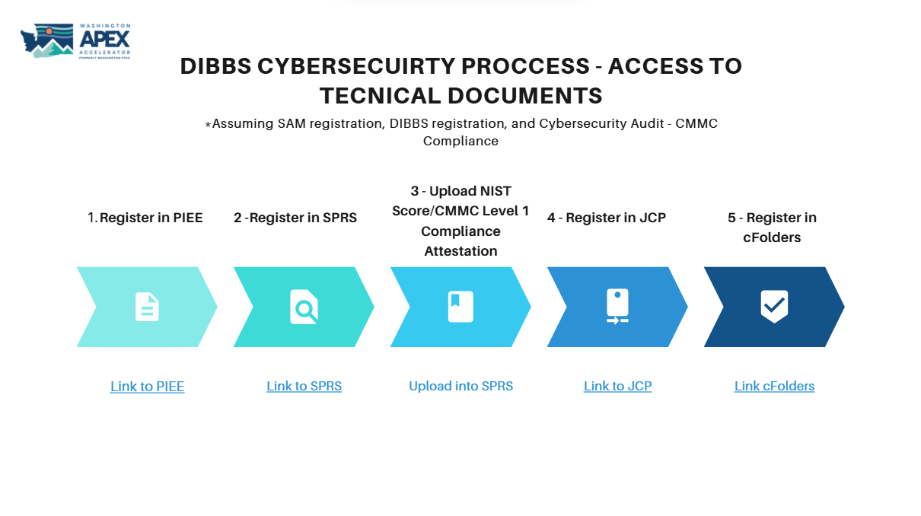

Slide 31
Solicitation Overview & Go No-Go Decisions

Slide 32
Fun Facts About DIBBS Solicitations
Solicitations:
If over 250k, typically will be an RFP
If under 250k, typically will be an RFQ
Average award amount is under 4k
May be advertised on SAM.Gov if over 25k
90% of solicitations are automated (generated, evaluated, and potentially awarded)
  Automated procurements have a “T” or “U” in the 9th position of the solicitation number - Ex: SPE7M114T0123
15% of National Stock Number (NSNs) are actively purchased 1G items
  1G – fully open for competition (manufacturers)
  No approved vendor list
  Government owned technical documents (c/folders – JCP – CMMC/NIST)

Slide 33
Key Elements in a Solicitation
NSN
Quantity
Unit of Measure
Required Delivery Date
Packaging Requirements
Inspection/Acceptance Points (Origin or Destination)
Award Method (Auto or Manual)
Previous Price (if listed)
Set-Aside Status (e.g., Small Business)
Part Number
Approved CAGE (or lack thereof)
CLIN

Slide 34
Automated vs Manual Award
Automated
Typically an RFQ
Usually under $150K
Requires very fast response (within hours or a day)
Awarded to the lowest responsible bidder
Manual
Typically an RFP
More complex or higher-dollar
May include technical specs, drawings, set-aside language
May allow for additional evaluation criteria (e.g., past performance)

Slide 35
RFQ vs RFP
Both RFQs and RFPs are based off the same framework, but given the nature of the opportunities the standard occurring sections differ.
RFQ
Cover Page
Section A – Solicitation/Contract Form
Section B – Supplies/Services & Prices (CLINs)/Packaging
Section F – Deliveries or Performance
Section H – Special Contract Requirements (if applicable)
Section I – Contract Clauses
Section K – Reps & Certs
Section L – Instructions to Offerors
Lean format. Focused on price, delivery, and eligibility. Technical/quality clauses incorporated by reference (Master Solicitation).
RFP
Cover Page
Section A – Solicitation/Contract Form
Section B – Supplies/Services & Prices
Section C – Description/Specs/SOW
Section D – Packaging & Marking
Section E – Inspection & Acceptance
Section F – Deliveries or Performance
Section G – Contract Administration Data
Section H – Special Contract Requirements
Section I – Contract Clauses
Section J – Attachments (drawings, data sheets)
Section K – Reps & Certs
Section L – Instructions to Offerors (proposal format, volumes)
Section M – Evaluation Factors for Award
Full Uniform Contract Format. Used mostly for best-value awards with negotiated proposals.

Slide 36
Solicitation Structure - RFQ
Cover Page:
1
Table of Contents w/ # of pages
Part I: The Schedule
2
Sections: A, B, F, H
Part II: Contract Clauses
3
Section: I
Part IV: - Representations & Instructions
4
Sections: K, L
Set aside Type
Issuing Activity / Contracting Officer
Master Solicitation Revision used

Slide 37
RFQ Quoting – Bid Type
Quoting on a DIBBS RFQ is done through the DIBBS system. The process is similar to filling out an online form.
There are four options you can select when choosing a bid type.
Bid Without Exception – Only option accepted by automated bid
Bid With Exception – This will prevent you from being selected for an automated award
Alternate Bid – This will prevent your bid from being considered, but will open alternate products to be considered for future procurements
No Bid – A way to delete a previously submitted bid

Slide 38
Solicitation Structure - RFP
Section A: Cover Sheet
1
Return by date & time
Set-a-side Type
Issuing Activity / Contracting Officer
Cover Page:
2
Same as above
Table of Contents w/ # of pages
Part I: The Schedule
3
Section: A thru H
Part II: Contract Clauses
4
Section: I
Part III: - List of Documents, Exhibits & Other Attachments
5
Section: J
Part IV: - Representations & Instructions
6
Section: K thru M

Slide 39
RFP Quoting
Unlike RFQs which are quoted through their automated system, most RFPs require you to fill out a form attached to the solicitation (part IV) and upload it to submit.
Keep in mind that there are actionable questions throughout the solicitation that require you to check a box in order to submit a responsive bid. As always in government contracting, read the solicitation in its entirety.

Slide 40
Manufacturer: SAR & AO
If you’re wanting to be an approved source for a specific NSN, there are two approaches you can take.
*Note: you’ll need access to the technical data to provide alternative products be it from the approved source, the DLA, or be it through reverse engineering
Source Approval Request (SAR): A Source Approval Request is a package of information provided by a prospective new supplier to become an approved source for procurement of an NSN.
Alternative Offer: An Alternative Offer is submitted for evaluation against an active solicitation in order for a company and their product information to be reviewed and potentially qualified as an approved source.

Slide 41
Go/No-Go Decisions
When identifying opportunities, it’s important to have a standard process or lens to view it through to know if it’s right for your business.
Having a stream of good and relevant questions while performing market research will ideally help you hone your bid pipeline. The following slides will touch share decision trees that you can adopt when doing your market research. They will be separated by the distributor vs. manufacturer perspective that are built into this presentation.
Common threads:
Both need to be CMMC Level 1 compliant (with certain COTS exceptions for distributors)
Both need a packaging solution priced in.
Differences:
Distributors need approved sources
Manufacturers want to seek opportunities without approved sources (open competition/government owned technical drawings)

Slide 42
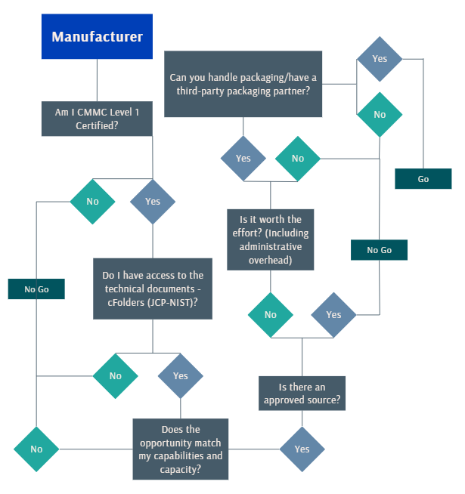
Go/No-Go Manufacturer
The decision tree for manufacturers is focused on access to technical documents and capability match.

Slide 43
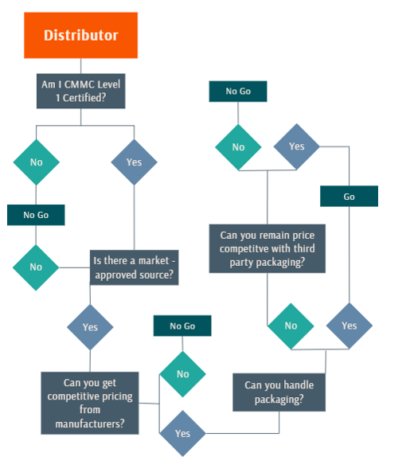
Go/No-Go Distributor
The decision tree flow for a distributor is focused on price competitiveness and packaging.

Slide 44
Delivering the Goods: Packaging, Marking & Shipping

Slide 45
Packaging & Marking Basics
There are three main standards to keep in mind when learning about packaging.
They are:
MIL-STD-2073-1E (How to package the item – protect contents and prepare for shipping/handling/storage)
This is a military standard that outlines the methods, materials, and procedures for packaging military supplies to ensure they are protected during handling, storage, and shipment.
MIL-STD-129R (How to label the item to stay in compliance)
This standard provides the minimum requirements for uniform military
marking for shipment and storage. Additional marking may be required by the contract or the
cognizant activity.
ASTM D3951 (Commercial Pack)
This standard provides basic protective guidelines and isn’t as stringent as MIL-STD requirements – may require only minor packaging adjustments or none at all.

Slide 46

MIL-STD-2073-1E
Standard Practice for Military Packaging
Decodes preservation, packaging, packing, and special marking requirements
Section B denotes packaging data
Required for long-term storage and/or items with specific protection needs that cannot be met with commercial practices
NOTE: If packaging data is missing, review paragraph 4.2 and notify contracting officer.

Slide 47

MIL-STD-129R
Military Marking for Shipment and Storage
Department of Defense uniformed marking requirements
Mandatory marking requirements for ALL DoD shipments to identify material and trace back to the contractor (labels available in the VSM)
NOTE: Review pictorial marking requirements within ASTM D5445 when special markings required.
Look out for RFID requirements

Slide 48
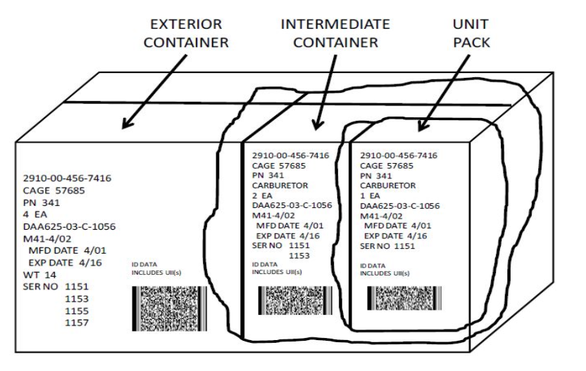

MIL-STD-129 Marking Examples
*Note that all packages require labelling

Slide 49

ASTM D3951 (Commercial Pack)
Standard Practice for Commercial Packaging
Establishes minimum requirements for packaging of supplies and equipment
Package design must facilitate multiple handling, shipment by any mode, and storage for minimum of one year in enclosed facility without damage to the product.
Unit package must also be ready for issue and redistribution without any additional packaging and/or marking.
NOTE: Only applicable when an acquisition document references this document solely.

Slide 50
Packaging Resources
Packaging is a common roadblock for vendors wanting to participate in DIBBS.
Be sure that you understand packaging before bidding on a solicitation. Issues that arise from a lack of understanding:
Shipping the wrong number of items/losing money
Not pricing in packaging correctly/losing money
Poor relationship with the DLA/lower odds of winning awards/losing money
Resources:
ASSIST-QuickSearch Basic Search – a DLA searchable database
Packaging Code Lookup – a packaging database that interprets codes (not an endorsement of their services)
Mil-Std-129R Labeling with IUID and RFID | Mil-Pac Technology – an overview of Mil-Std-129R from a private company (not an endorsement of their services)

Slide 51
Shipping - VSM Module
The DLA’s Vendor Shipping Module (VSM) is a DLA enterprise wide, web-based system that supports cargo movement from DLA suppliers to DLA customers and DLA warehouses.
Link to VSM: VSM - Vendor Shipment Module > Defense Logistics Agency > Details
Some functions of the VSM:
DLA suppliers access VSM to notify DLA that an FOB Origin order is ready for pickup
DLA suppliers access VSM to print Military shipping labels which contain correct addressing.
  In addition, package or box labels, BOLs, and packing lists will print dependent on whether the order is FOB Origin or FOB Destination

Slide 52
FOB Origin vs FOB Destination
FOB, or Free on Board, is a shipping term that defines the point in the supply chain when a buyer or seller becomes liable for the goods transported. Purchase orders between buyers and sellers set FOB terms and help determine ownership, risk, and transportation costs.
FOB Origin= DLA manages and pays for transportation
FOB Destination= Supplier manages and pays for transportation (price into bid)
Notes:
  Whether a solicitation is FOB origin or FOB destination will be noted in Block 8 of the solicitation
  Use of VSM is a requirement
  Supplier enters shipment details, weight, pieces, and dimensions into VSM for both options

Slide 53
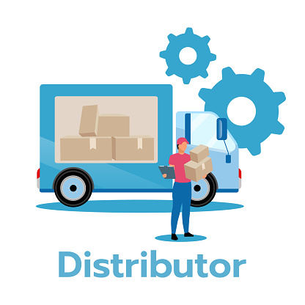












Logistics
You may have multiple touch points in your shipment. You want to minimize them as you will have to price the additional shipping into your bid.
Manufacturer as origin: the manufacturer has the capabilities to meet the packaging requirements (may or may not have a distributor involved)
  - Example: Commercial Packaging
Packaging company as origin: manufacturer is unable to meet the packaging requirements (may or may not have a distributor involved)
Distributor as origin: manufacturer is unable to meet the packaging requirements - there needs to be minor packaging/labelling corrections that the distributor can handle
*There may be multiple delivery points per solicitation
🔺 “More touch points = higher cost & complexity”

Slide 54
Takeaways
The goal of this presentation was to break down DIBBS into actionable steps, and to provide an practical perspective when approaching the system.
DIBBS has a variety of robust opportunities
Cybersecurity compliance is a required step in participation
There are two pathways to take in DIBBS – Manufacturer or Distributor
  Manufacturers should pursue 1G open competition solicitations with government owned tech docs
  Distributors should pursue solicitations with approved sources
Maintain a list of your FSCs/PSCs, NSNs, and solicitations of interest
Learn packaging and marking requirements inside and out before bidding on solicitations

Slide 55
Resources

Slide 56

https://www.dla.mil/Small-Business/Forecast-of-Contracting-Opportunities/ - DLA’s small business resource page
DLA Land & Maritime DIBBS PPTs Link to SharePoint folder containing all of the DIBBS PowerPoints offered by DLA Land & Maritime TKO training
YouTube – beware of “I made millions by drop shipping in DIBBS, and you can too!” type videos. There are helpful videos showing the bid process.
Your local APEX Accelerator
DLA Land & Maritime Training, Knowledge, and Opportunties (TKO) seminars (virtual and in-person) DLA Training, Knowledge, and Opportunities (TKO) Seminar > Outreach Calendar

Slide 57
Other APEX Accelerators Serving Washington State
1 Kitsap Economic Development Alliance
  Mary Jo Juarez, Terry Homburg, James Davis
North Olympic Peninsula
APEX Accelerator:
clallam.org/apex
American Indian Chamber Education Fund APEX Accelerator: aicef-apex.org
NW Native Apex Accelerator:
nnapex.org
2 Thurston Economic Development Council
  Grady Smith
Innovation & SBIR Program
washingtonapex.org/sbir
3 Columbia River Economic Development Council
  Julia Krivoruk
4 Economic Alliance Snohomish County
  Cara Buckingham, Mark Johnson
5 Green River College
  Darrell Sundell, Melinda Martirosian
6 Washington APEX Accelerator in Pierce County
  Trena Payton, Maryam Lynch-Tate
7 Greater Spokane Incorporated
  Aleesha Roedel
See full staff listing at washingtonapex.org/about-apex/staff
8 Tri-City Regional Chamber of Commerce
  Maria Alleman
360.860.6945 info@washingtonapex.org washingtonapex.org
“This APEX Accelerator is funded in part through a cooperative agreement with the Department of Defense.”
Notes:
This is a editable map.
MUST have all fonts installed on your computer to see it properly.

Slide 58
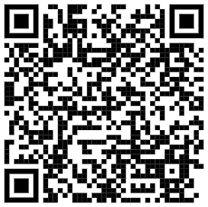
Contacts
Cara Buckingham
WA APEX Accelerator @ Economic Alliance Snohomish County (EASC)
425.248.4223
carab@economicalliancesc.org
Mark Johnson
WA APEX Accelerator @ Economic Alliance Snohomish County (EASC)
425.248.4222
markj@economicalliancesc.org
For additional training opportunities, visit
Washington APEX Accelerator’s Calendar of Events

